Slide 1

NYC Flights

Slide 2

01
Introduction
02
Method & Packages
03
Airline Delays and Analysis
04
Potential Delay Causes
05
Conclusion

Slide 3
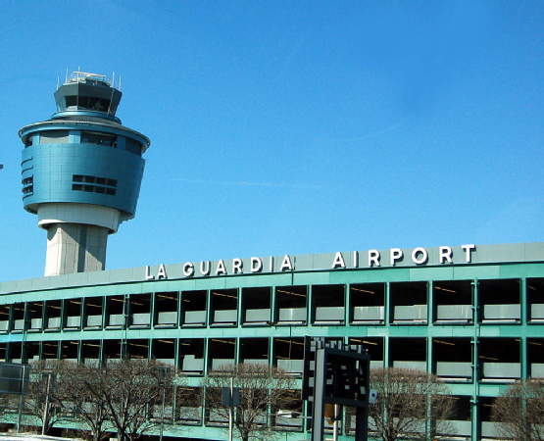
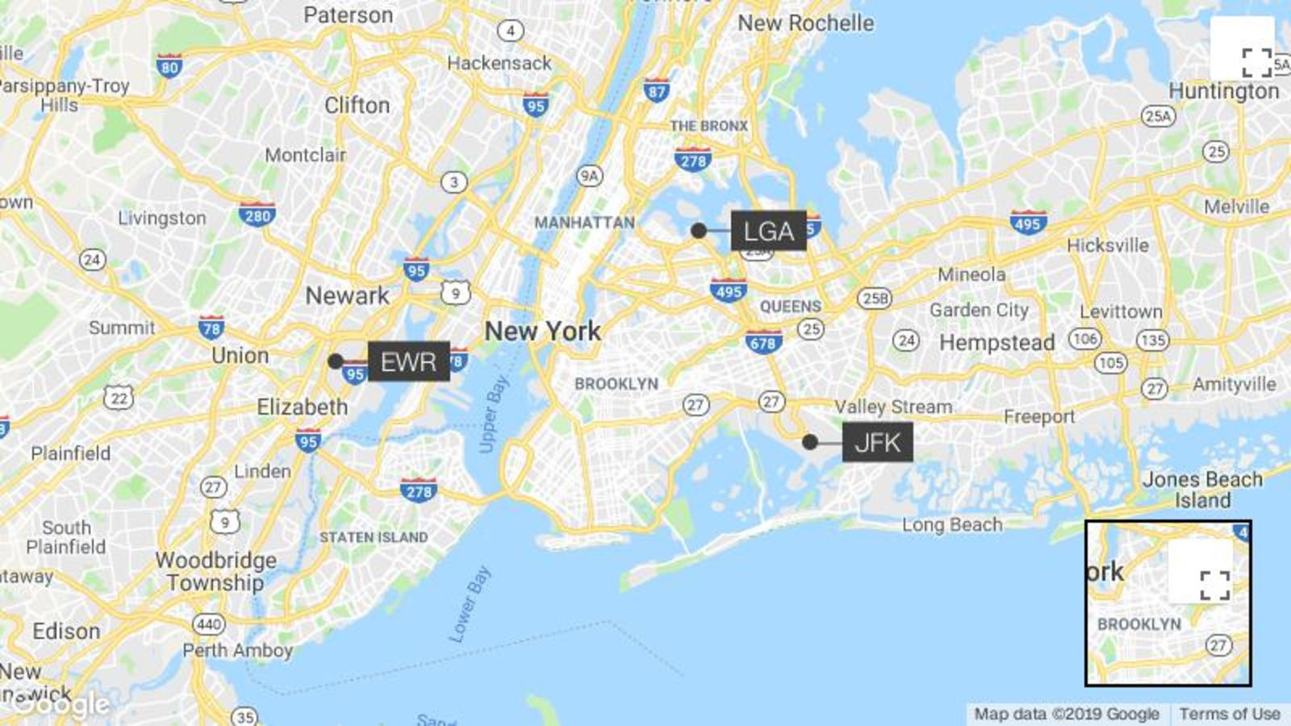
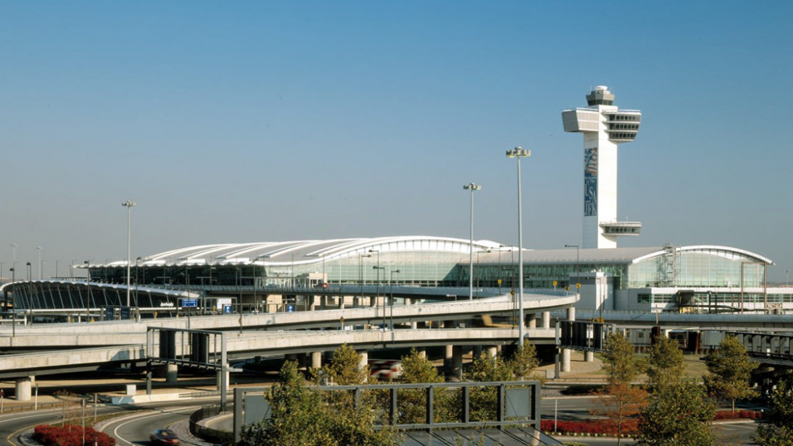
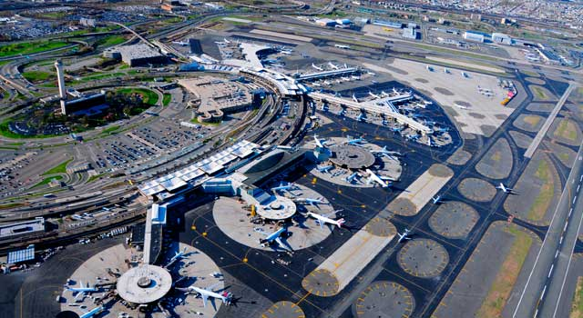
Introduction
 | LaGuardia Airport (LGA)
 | Newark Liberty International Airport (EWR)
 | John F. Kennedy International Airport (JFK)

Slide 4
airlines
airport
flights
planes
weather
Nycflights13
Method & Packages

Slide 5
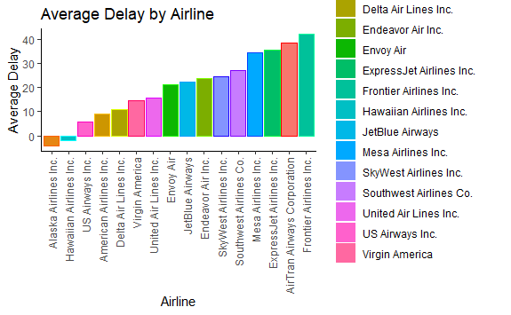
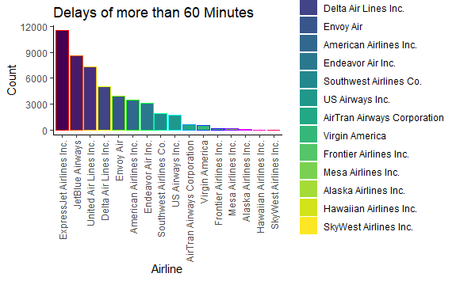
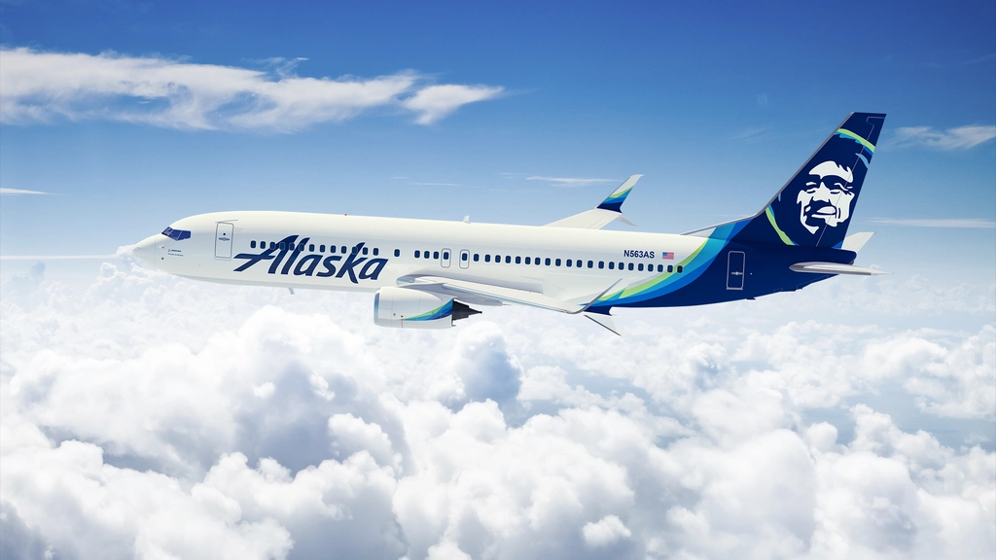
Airline delays and Analysis

Slide 6
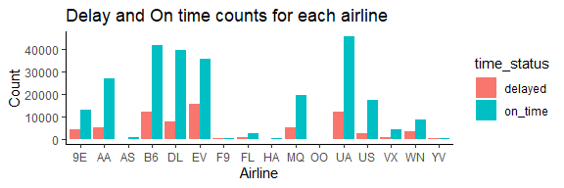
Punctuality across all airlines

Slide 7
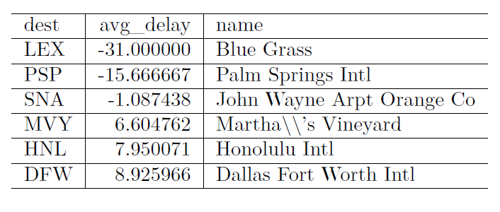
Best airport punctuality performers
Allied to the map above, the top 6 performing airlines,
when ranked by punctuality are:

Slide 8
Mapping Airport Delays
https://rpubs.com/suedge12/757742

Slide 9
Weather
Potential Delay Causes
Planes
Congestion

Slide 10
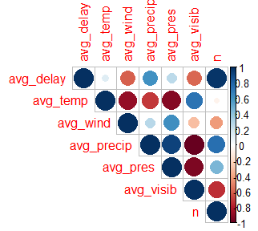
Weather

Slide 11
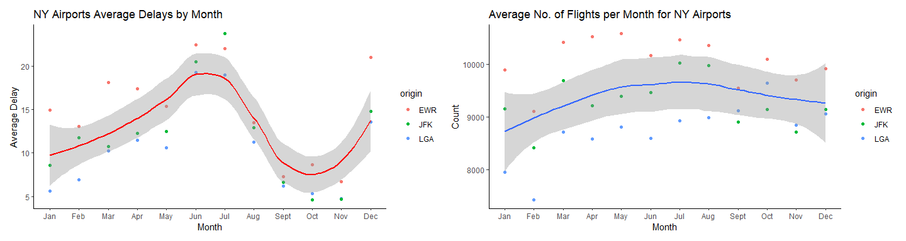
Congestion
Delays are biggest in June and July,
this coincides with high flight numbers at the three airports.

Slide 12
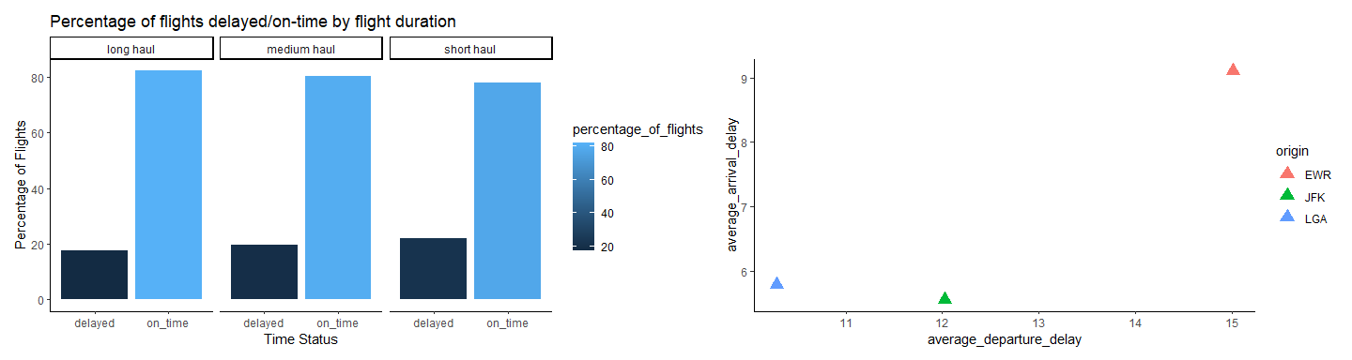
short, medium or long haul
Long haul flights had better punctuality, both in terms of on time arrivals and also lower
numbers being delayed.

Slide 13
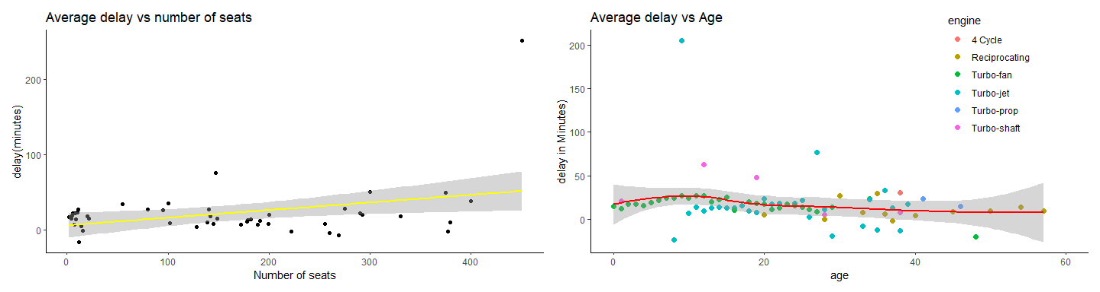
Plane
The plot on the left, as the number of seats increases, so too does the delay.
Turning to age, the result is less conclusive..

Slide 14
Conclusion
Newark is the busiest airport,
it suffers more departure and arrival delays than JFK or La Guardia.
Weather should not be a major concern
as wind, rain, humidity don’t appear to influence punctuality as much as congestion does.
Smaller plane will suffer less delays.
Flying to Blue Grass, Palm Springs or John Wayne airports most likely arrive ahead of time.

Slide 15
Thank you

